Slide 1
Transportation Cost Prediction Using Machine Learning
Supporting More Accurate Customer Quotes at Gallagher Transport International
Maryi Tatiana Palacios Giraldo | Regis University | Practicum II
August 2026
Notes:
Open with the audience and the decision problem. This is not a model presentation; it is a proposal to improve how brokers prepare customer quotes.
[Sources]
- Internal project presentation and project notebook.

Slide 2
Gallagher should pilot a quote-range tool to help brokers prepare more accurate and consistent customer quotes.
THE ANSWER
DECISION
Use the quote-range tool for routine shipments, with human review for unusual or wide-range cases.
89.3%
future costs captured by the range
Owner: Brokerage leadership
Value: more consistent quotes, transparent uncertainty, and fewer avoidable margin surprises
Notes:
Lead with the decision. Ask leadership to approve a controlled pilot—not to approve an algorithm. Explain that the tool changes broker behavior by replacing a single manual guess with an estimate plus a reviewable range.
[Sources]
- Internal project notebook: observed test coverage 89.31%; median absolute error $534.79.

Slide 3
Gallagher's 7,167 finalized shipments represent a business dominated by sea and air transportation.
SITUATION
DECEMBER 2025 – JUNE 2026
9,720
original records
7,167
finalized shipments used
Brokers must quote before the final transportation cost is known.
Notes:
Introduce Gallagher's operating context and the dataset. Sea and air represent about nine of every ten finalized records, but the broker still has to quote before the final cost is known.
[Sources]
- Internal cleaned shipment dataset: 7,167 finalized records from 9,720 original records.

Slide 4
Typical transportation cost differs sharply by shipment type, so one reference price cannot support every quote.
SITUATION
BUSINESS IMPLICATION
SEA's typical cost was about 19× AIR's typical cost.
The quote needs to reflect the shipment's operating profile.
Eligible shipments: AIR 2,220 • TRK 255 • SEA 4,247
Notes:
Use the medians as executive-friendly typical costs. Explain that the comparison is descriptive and shows why a single reference amount cannot work across transportation types.
[Sources]
- Internal cleaned shipment dataset: median final cost by transport type.

Slide 5
Transportation costs shifted across months while future disruptions remained difficult to anticipate at quote time.
COMPLICATION
DIFFICULT TO KNOW IN ADVANCE
Carrier and fuel changes
Capacity shortages
Congestion and weather
Route or handling changes
Storage, detention, surcharges
The trend shows variation—not the cause of each monthly change.
Notes:
Explain that historical typical cost moved across the seven-month period. Do not claim that the listed disruptions caused the chart; they illustrate why future cost remains uncertain at quote time.
[Sources]
- Internal cleaned shipment dataset: monthly median final transportation cost.

Slide 6
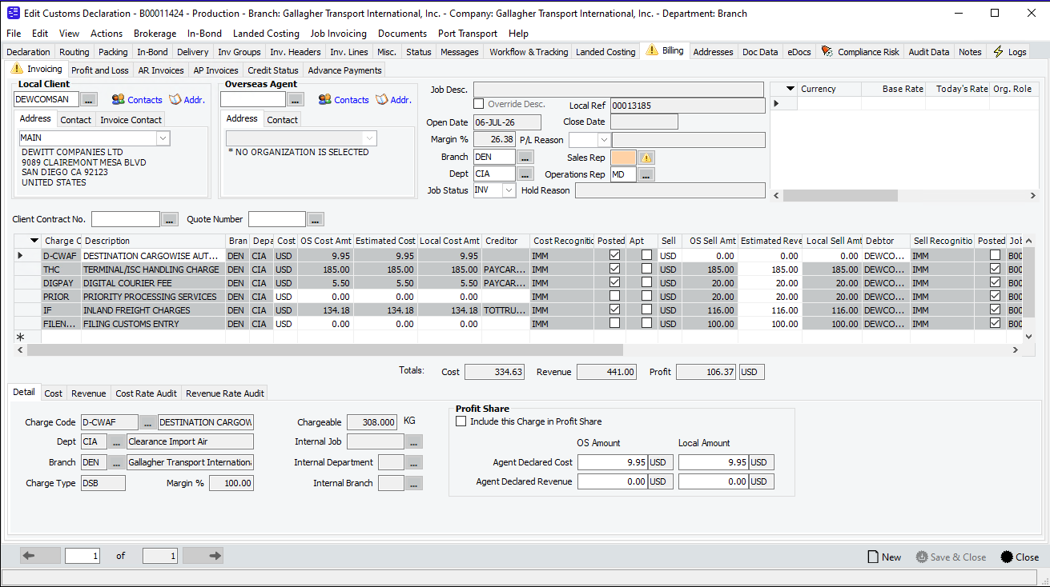
One underquoted shipment shows how cost uncertainty can become unrecovered revenue.
COMPLICATION
WHAT HAPPENED
Quote too low
↓
Final cost was higher
↓
Customer declined the adjustment
↓
Revenue was not recovered
The screenshot is evidence of the billing context; the loss amount is not estimated here.
Notes:
Tell the case briefly: the initial quote was below the final cost, the customer did not accept the increase, and the company did not recover the difference. Do not state a dollar loss unless the original quote and final cost are documented.
[Sources]
- Internal operational screenshot supplied by the project author; customer outcome described by the project author.

Slide 7
The tool turns quote-time shipment details into an estimated final cost and a transparent range.
RESOLUTION
BROKER INPUTS
QUOTE SUPPORT
Transport type
Mode and branch
Origin and destination
Weight, volume, containers
Quote date
HISTORICAL COST PATTERNS
Estimated cost
Uses historical shipment patterns
without exposing model details to the broker
Suggested low – high range
Live prototype: a broker opens one local form and receives the estimate in seconds.
Notes:
Transition into the live demo. Enter one realistic shipment, show the estimated cost and range, then return to the deck. Avoid explaining algorithms.
[Sources]
- Internal Streamlit prototype and exported trained model bundle.

Slide 8
The range captured 89.3% of future costs, but uncommon shipments still require broker judgment.
RESOLUTION
TARGET
90.0%
89.3%
RESULT
observed coverage
0.69 points below target
Within the predefined two-point tolerance → PASS for a controlled pilot
Notes:
Explain coverage without statistics jargon: about 89 of every 100 future test shipments landed inside the suggested range. The target was 90, so the result is close enough for a controlled pilot, not unrestricted deployment.
[Sources]
- Internal project notebook: requested coverage 90%; observed test coverage 89.3123%; tolerance 2 percentage points.

Slide 9
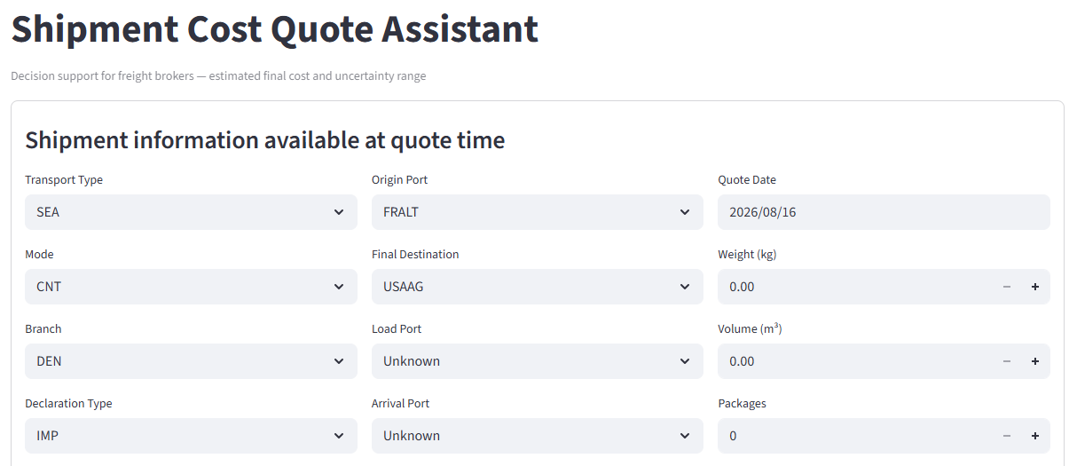
The working prototype fits the broker workflow and keeps unusual cases under human review.
RESOLUTION
HOW IT WORKS
1
Broker enters the information already available at quote time.
2
The tool returns an estimated final cost and suggested low–high range.
Result: a faster, consistent starting point—while the broker keeps final judgment.
Notes:
Use this slide to introduce or conclude the live demonstration. Point out that the fields reflect information available when quoting. Enter one realistic shipment and show the estimated cost and range; do not explain the underlying algorithm.
[Sources]
- Internal Shipment Cost Quote Assistant screenshot supplied by the project author.

Slide 10
A 90-day pilot can measure whether the tool improves quote consistency, speed, and margin protection.
PAYOFF
90-DAY PILOT
DAYS 1–30
DAYS 31–60
DAYS 61–90
MEASURE
Coverage
Range width
Quote time
Broker adoption
Quote changes
Margin leakage
Train a small broker group
and capture every tool-assisted quote
Compare estimate, range and final cost
by mode, branch and route
Review pilot evidence
and decide scale, recalibrate or stop
Decision requested today: approve pilot ownership, broker participants and measurement discipline.
Notes:
Close by asking for a specific decision: pilot owner, participants and measurement discipline. Do not promise a financial return that has not yet been measured; make margin protection a pilot metric.
[Sources]
- Internal project recommendation; no unmeasured financial benefit is claimed.

Slide 11
Typical estimates are close, but uncommon expensive shipments still create large misses.
APPENDIX
HONEST LIMITATION
The tool performs much better on routine shipments than on rare, high-cost cases.
That is why the operating design includes a range and a human-review path.
Notes:
Use plain language: half of shipments are within about $535, but a small number of difficult shipments create much larger errors. This is the limitation slide the previous deck was missing.
[Sources]
- Internal project notebook: median absolute error $534.79; MAE $3,279.55; RMSE $11,551.79.

Slide 12
Brokers can use the tool for routine quotes and escalate wide or unusual cases for review.
APPENDIX
USE THE RANGE
HUMAN REVIEW
Routine mode and route
Complete quote-time inputs
Range is commercially usable
No unusual services or surcharges
Rare or unfamiliar route
High-value shipment
Missing critical information
Range is too wide to support a quote
The tool supports broker judgment; it does not replace it.
Notes:
This is the operating policy. The tool handles routine cases; people handle exceptions. Emphasize that wide ranges are signals to investigate, not failures to hide.
[Sources]
- Internal project recommendation based on model error and interval-width diagnostics.

Slide 13
The evaluation used finalized historical costs and preserved time order to simulate future quotes.
APPENDIX
9,720
7,167
4
raw shipment records
eligible finalized shipments
chronological partitions
CLEANING RULES
Only invoiced records • Excluded cancelled $0 costs • Excluded provisional $9.95 costs • Converted accounting sign to positive cost
Train → validation → calibration → final test
Notes:
Use only for methodology questions. Explain that final costs were filtered using business rules and that later months were reserved to simulate future performance.
[Sources]
- Internal project notebook and source dataset audit.

Slide 14
Thank you

